Slide 1
Follow me on
@jfwinkler
Jim
Winkler

Slide 2
The fortune is in
The Follow Up!

Slide 3
Follow Up and duplication
Follow Up with customers
and potential customers
Follow Up with prospects
Follow Up with new
business partners to create duplication

Slide 4
Follow up when a customer receives the products
Follow up a week or two later and ask how they like the products
Follow up towards the end of the product life cycle
Follow Up with a customer
Make sure they download ShopBuddy

Slide 5
Take good notes on what you sell each transaction. Take even better notes on samples given and what is going on in your customers lives

Slide 6
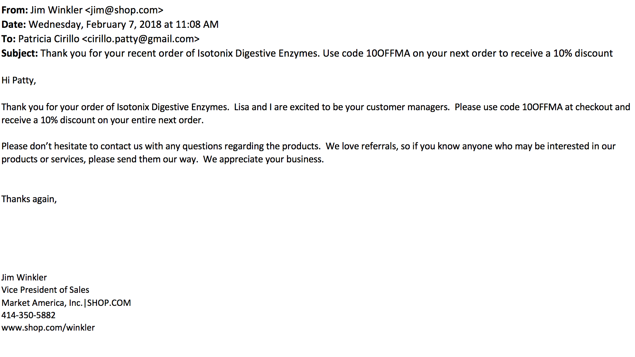

Slide 7
Follow Up and duplication
Follow Up with customers
and potential customers
Follow Up with prospects
Follow Up with new
business partners to create duplication

Slide 8
Scheduling the Follow Up
Point of Contact
To
Point of Contact

Slide 9
How you rate yourself based on the information that you have seen today?
Interested in trying products
Interested but confused – how do I get more information
I have seen enough – I am ready to get started

Slide 10
How you rate yourself based on the information that you have seen today?
Interested in trying products
Answer – Great! Which of the products were you interested in –OPC-3 / Ultimate Aloe

Slide 11
How you rate yourself based on the information that you have seen today?
Interested in trying products
Interested but confused – how do I get more information
Answer – What information would you have more interest in – products, business, company, how to make money? (ticket)

Slide 12
How you rate yourself based on the information that you have seen today?
Interested in trying products
Interested but confused – how do I get more information
I have seen enough – I am ready to get started
Answer – Great – Lets set an appointment to register your business and I will email you all the getting started information

Slide 13
Scheduling the follow up appointment
It is a successful meeting if a
follow up is
booked
Have your schedule available and book the next step
Schedule a follow up meeting to answer questions or get started
You have to continue to follow up until they get started or let you know they are not interested
Sense of urgency is crucial, book the follow up within 48 to 72 hours if possible

Slide 14
Scheduling the
follow-up appointment
If it is to answer questions
If it is to get them started
Answer questions
Sell tickets
Get them to lead to their people
Book registration date
Sell product
Help qualify top ten possibilities
Sell tickets

Slide 15
Next Step
One on One or Two on One meeting
Home Business Presentation
Online meeting (join.me, Skype)
UnFranchise® Business Presentation
Invite to an event/Sell a ticket
(upcoming meetings or trainings)

Slide 16
Confirm the next appointment
Send them a webinar link
Send them About MA document or marketamerica.com/
Send them videos (YouTube, MeetOn, Power Profiles)
WHAT TO DO BETWEEN APPOINTMENTS
Schedule a three way call with senior partner

Slide 17
Tools for Follow Up
UnFranchise Business Presentation (PPT)
23 minute video (YouTube)
Ticket to the next event
Adding to a FB group
Trial Size Products/Product Catalogs
Power Profiles
UnFranchise® Owner Magazine
Global Annual Report
About MA (download)
Websites (SHOP.COM, MotivesCosmetics.com, etc.)
Marketamerica.com
Home Shopping List / Shopping Annuity® Assessment
Follow Up Tools

Slide 18
How to use a high level skill person to close the prospect or move them forward
3 – Way Calls

Slide 19
How to create urgency to get someone to make a decision

Slide 20
Do your prospects end up in the Prospect Protection Plan?
(You can’t get in touch with them)
If they do, it can happen because of what you are or what you are not saying to them!
Too much time has gone by!
(thermometer)

Slide 21
How long do I keep calling someone who stopped returning calls?
Three Strikes and Out!!

Slide 22
Follow Up and duplication
Follow Up with customers
and potential customers
Follow Up with prospects
Follow Up with new
business partners to create duplication

Slide 23
We Get So Excited to Recruit a New Business Partner!

Slide 24
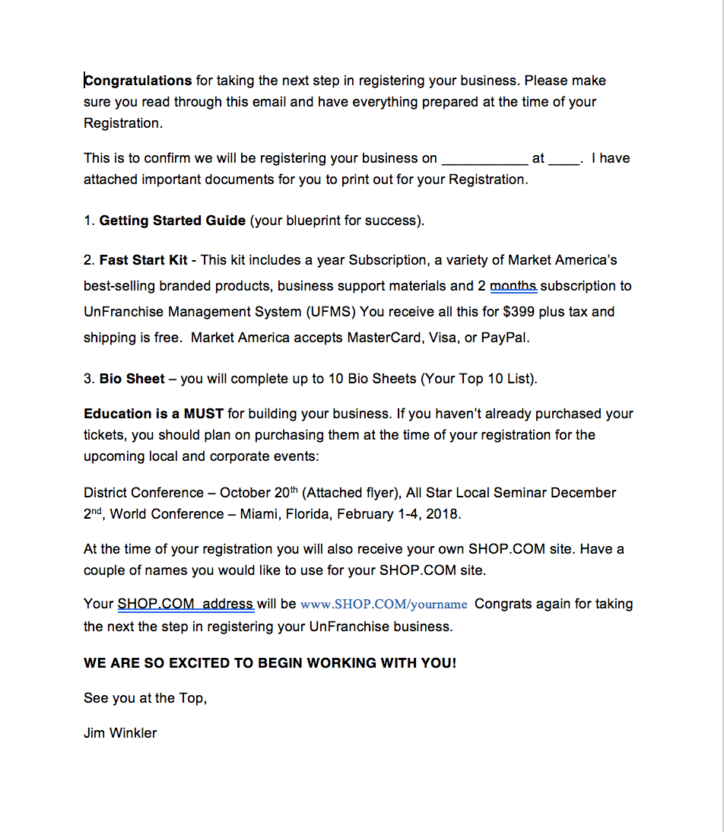
Pre Registration Email

Slide 25
VENUE PICTURE
2018
19 – 21 October 2018
MARKET HONG KONG
LEADERSHIP
SCHOOL
SKU 2188_HKLS18

Slide 26
The Getting Started Guide is your roadmap for your first year as an UnFranchise® Owner

Slide 27
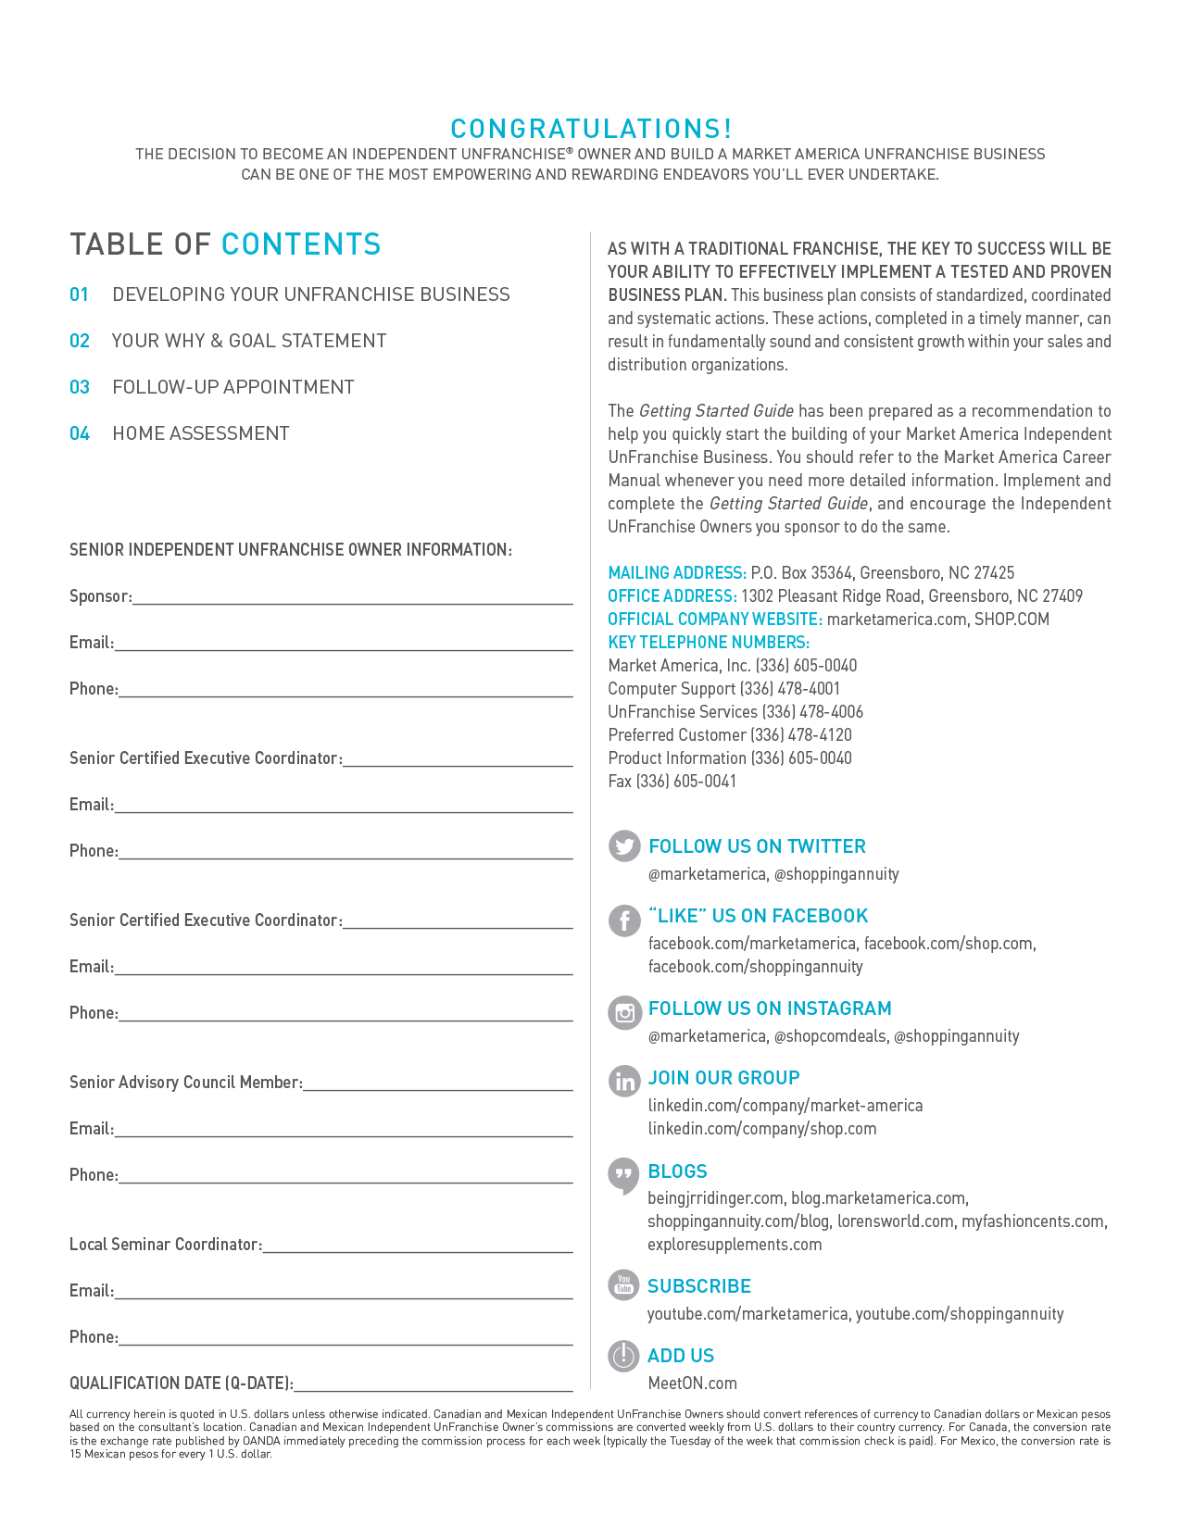

Slide 29
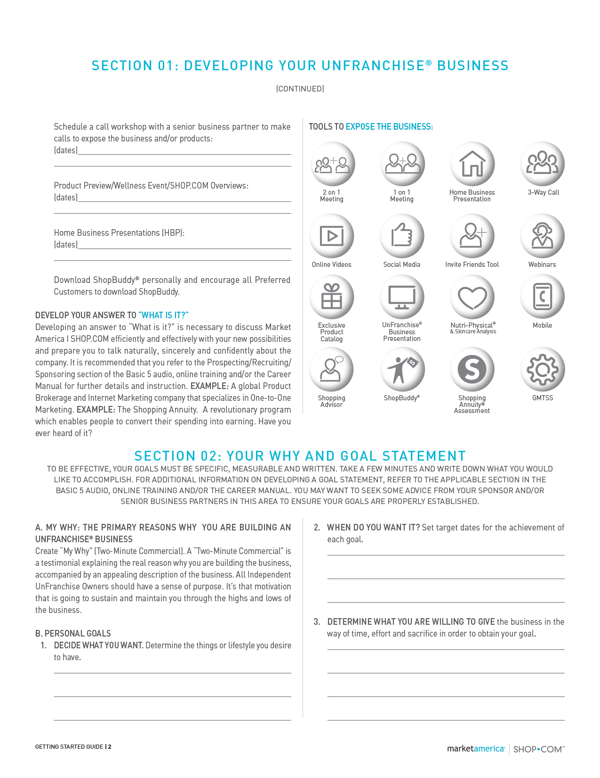

Slide 30
Replace products they are currently purchasing with branded products using the Home Shopping List and Shopping Advisor
Teach them how to introduce potential customers to their SHOP.COM website through the "Invite Friends" tool
Schedule a Product Preview or SHOP.COM website overview within the first month of starting their business
Develop a Retail Customer Base with Your New Partner

Slide 31
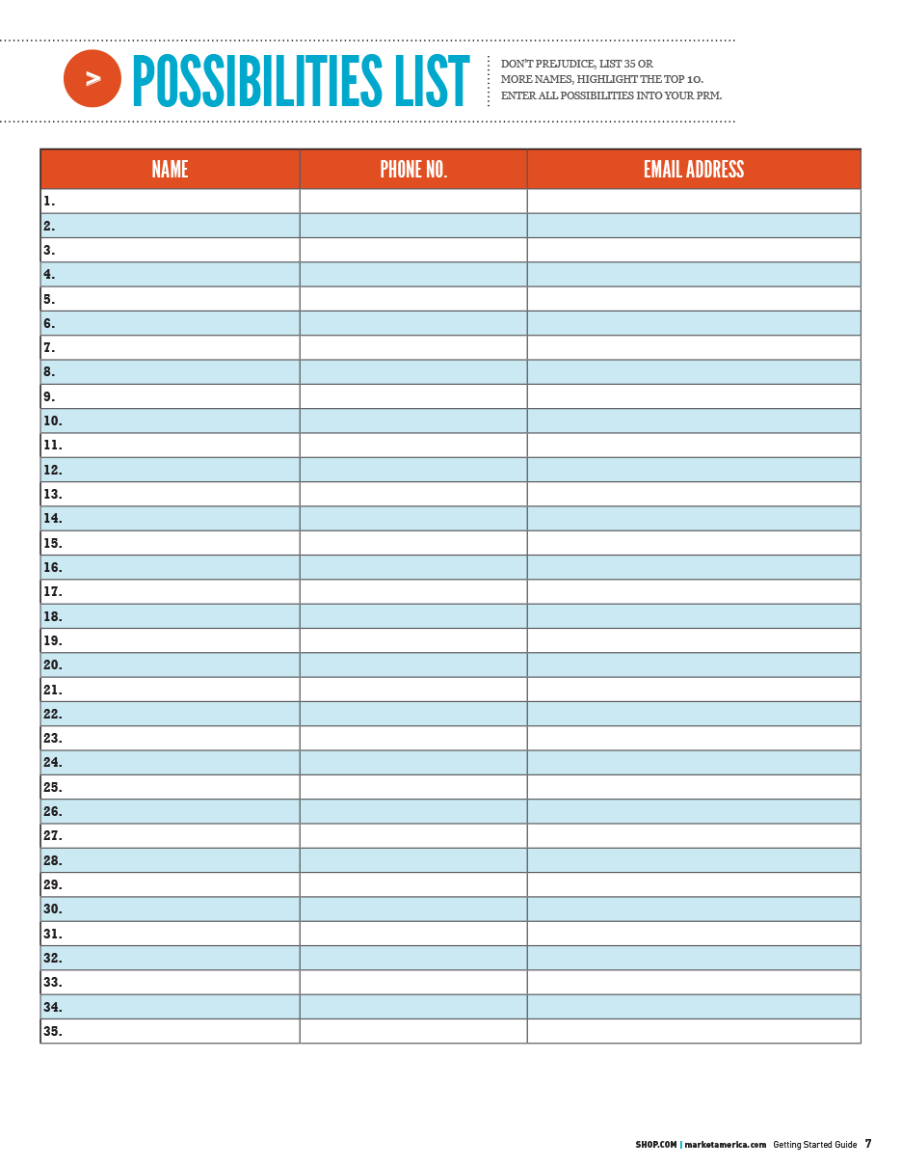
Develop a Possibilities List of 60-200 names with your new partner

Slide 32
Follow UP
Spend time reviewing SHOP.COM and UnFranchise® Business Account
Review Help & Training section in the UnFranchise Business Account

Slide 33
Review Possibility List
Follow Up on Prospecting
Determine Top 10 prospects with your new partner
Decide on Approaches for Top 10
Develop answers to:
What do
you do?
What is it?
Your reason why

Slide 34
Schedule Call Workshops and 3-Way Calls to Introduce the Business

Slide 35
Are You Mentally Tough Enough?
Use the GMTSS to Teach, Train and Retain

Slide 36
What are you going to do get there?
Local Seminars (Scheduled)
UPB’s
District Convention
International Convention
World Conference
NUOT, B5, ECCT
Product Trainings

Slide 37
Consistency and Leadership

Slide 38
Consistency and Routines
Can’t start and stop
Show up
Don’t let life get in the way of living
Give it your all for two to three years
Do it right!

Slide 39
Commitment
and
Discipline

Slide 40
Add Two Possibilities
Call One
Show One Business Plan

Slide 41
Show me your routines, habits and rituals and I’ll show you your future…..

Slide 42
You have to
“DO SOMETHING”

Slide 43
When?
The time will never be right!
You will always be too busy!
Money will always be tight!
Someone will always be negative!
There will always be something that looks easier or promises you that you don’t have to do any work.
The economy will always be up and down.

Slide 44
A Business of Inconvenience
It’s easier not to talk to people
It’s easier not to listen to audios
It’s easier not to write a goal statement
It’s easier not to make the phone calls
It’s easier not to come to the seminars
It’s easier to miss the UBP’s
It’s easier to watch TV every night
It’s easier to be broke

Slide 45
You need to be inconvenient for 2 to 3 years to be convenient the rest of your life

Slide 46
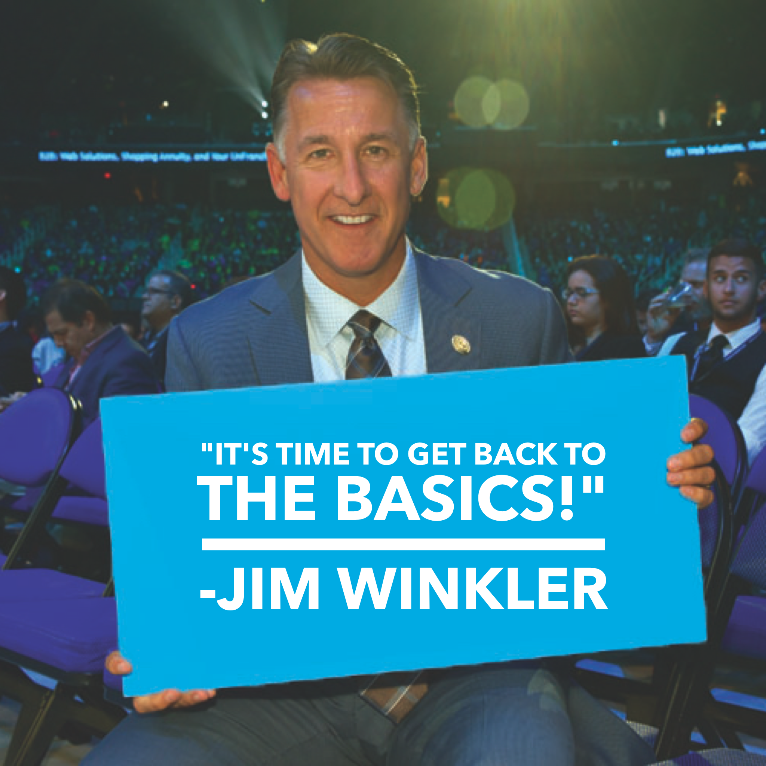

Slide 47
Result Producing Activities
Show the plan
Use and share the products
Sell tickets
Build in the homes
Shopping Annuity Master Member
Master UnFranchise Owner

Slide 48
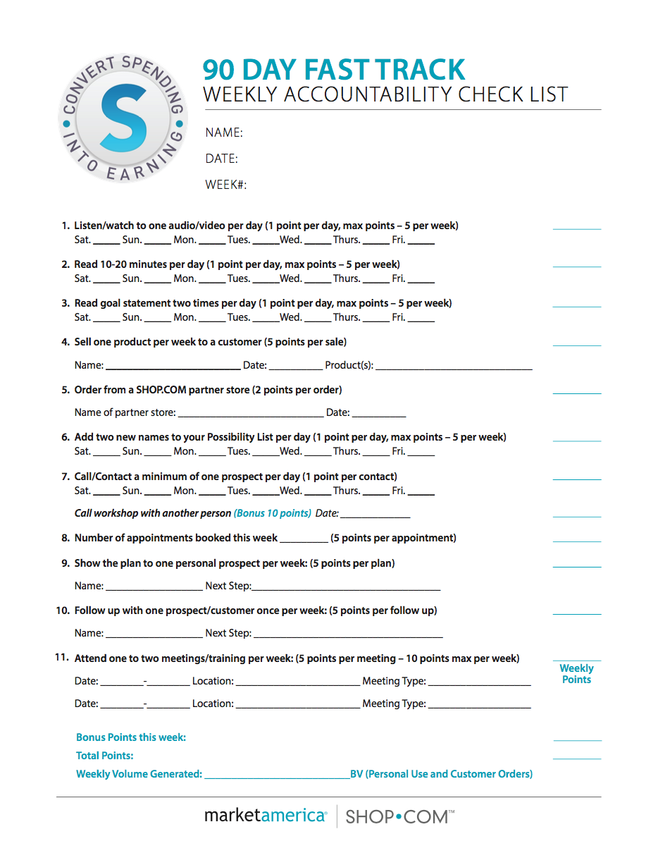

Slide 49
#1 Reason that people don’t succeed
Excuses

Slide 50
#2 Reason that people don’t succeed
More Excuses

Slide 51
#3 Reason that people don’t succeed
Constant Excuses!

Slide 52
Eight Audios/Books
Failing Forward John Maxwell
The 21 Irrefutable Laws of Leadership John Maxwell
Rich Dad, Poor Dad Robert Kiyosaki
Cash Flow Quadrant Robert Kiyosaki
Go Pro Eric Worre
Building an Empire Brian Carruthers
The Slight Edge Jeff Olson
Lower Your Taxes Big Time Sandy Botkin

Slide 53
Sometimes…
We have doubts
It is harder than we thought
Someone on our team quits
What if it doesn’t work for me
My people don’t listen
My people don’t do anything!
It’s not going fast enough

Slide 55
Some People Will…
Decide to take a break
Slow Down
Start hanging around negative people
Stop attending any trainings and meetings
Start making excuses
Settle for a life they don’t want

Slide 56
Ten Years from
now they will still be
complaining about
the same things in life!
Telling everyone how they can’t get a break…

Slide 57
Some People Will…
Renew their commitment
Decide to try twice as hard
Read better books – listen to better audio tapes – GROW!
Do Simple RPA’s everyday
Hang around positive people
Attend every training and meeting
Decide to never give up

Slide 58
Some People Will…
Take constructive criticism
Measure, monitor and change course
Take personal responsibility
Work harder, care deeper, and help more people
Strive instead of settle…

Slide 59
Ten Years from
now they will live the life that they have always dreamed of!
Still everyone will say,
that they got lucky…

Slide 60
Leadership
Your long term income will be determined by the example that you set and the things you do

Slide 61
Gaming Issues and Manipulation of the MPCP
Retail (Reseller) establishments
Sales/Auction websites (i.e. Amazon, Ebay, Yahoo, Shoppee, Taobao, etc.)
Countries Market America’s UFOs are not authorized/licensed to sell direct
People going into other UFO’s UnFranchise.com (back office) and filing fraudulent Form 1000’s or placing orders
Management responsibilities

Slide 62
These POLICIES, RULES, REGULATIONS have been in place for 26 years:
To maintain a level playing field for all UFOs
To protect/maintain competitive suggested retail price
To protect our brand
To protect the UnFranchise® Business

Slide 63
Violation of these prohibited activities/practices by Individual UFOs or Teams of UFOs have resulted in:
Prices driven lower and lower as more Violating UFOs use Auction Sites and Resellers to “Beat the System”
Difficulty in selling products at SRP or even a profit
Difficulty in keeping repeat customer base
Frustrating and demotivating UFOs across every line of sponsorship

Slide 64
Don’t Be A Boss
Most people already have one boss that they don’t like. Be a servant leader – prove that you want to help them and do the activities to back that up.

Slide 65
You don’t manage people. You lead people and you manage things
How do you become a great leader or income earner?
By doing the things that you expect your group to do

Slide 66
Are you a Leader?
Leaders do not create followers, they create new LEADERS!
A leader is someone who demonstrates what is possible

Slide 67
Leaders
Work with people at the level they are at
Good listening skills
Empathy (but don’t commiserate)
Problem Solving Skills (I hear you and understand but how can we make this work for you) The more problems you solve the more money you will make
Caring
Integrity
Always learning
Lead by example

Slide 68
Benefits of Business Growth
More friends
More family
Better health
Sense of purpose
Options in life
Security
Personal Growth

Slide 69
It’s Worth It!

Slide 70
The ABC Business Pattern
Remember, it never unfolds perfectly, it will duplicate through GO NOWS who are seeking to master the B5
After each meeting schedule another meeting (HBP, product preview, webinar) to invite prospects to
Always book the next appointment (follow up)

Slide 71
DUPLICATION COMES FROM THE
BOTTOM UP, NOT THE TOP DOWN
Light the fire in the basement not the attic!

Slide 72
THE ABC PATTERN GIVES YOU
Control Over Your
Success
Growth
Progress
Timing
It takes the chance out of it

Slide 73
Ongoing Steps to Success
Use and share the products
Maintain a minimum 10 customers ordering at least 30 BV and 20 IBV per month
Show the business plan twice each week
Continue to work in the homes (ABC Pattern)
Personally sponsor two new business partners per quarter
Achieve Master UFO program quarterly

Slide 74
Ongoing Steps to Success
Attend a minimum of one training per month (B5, NUOT, ECCT, specialized trainings, Local, District, Regional)
Attend the Market Hong Kong Annual Convention and Leadership School annually
Duplicate success by buying and selling tickets to your current and new team members (and prospects)
As your business grows continue to communicate and work with your team

Slide 75
Lead by example.
You must succeed so
other people can
realize their dreams.
-JR Ridinger

